Slide 1
Name: Swapnil Ghosh
Roll: 001911001067
Dept: IT
Group: A2
TASK 5

Slide 2
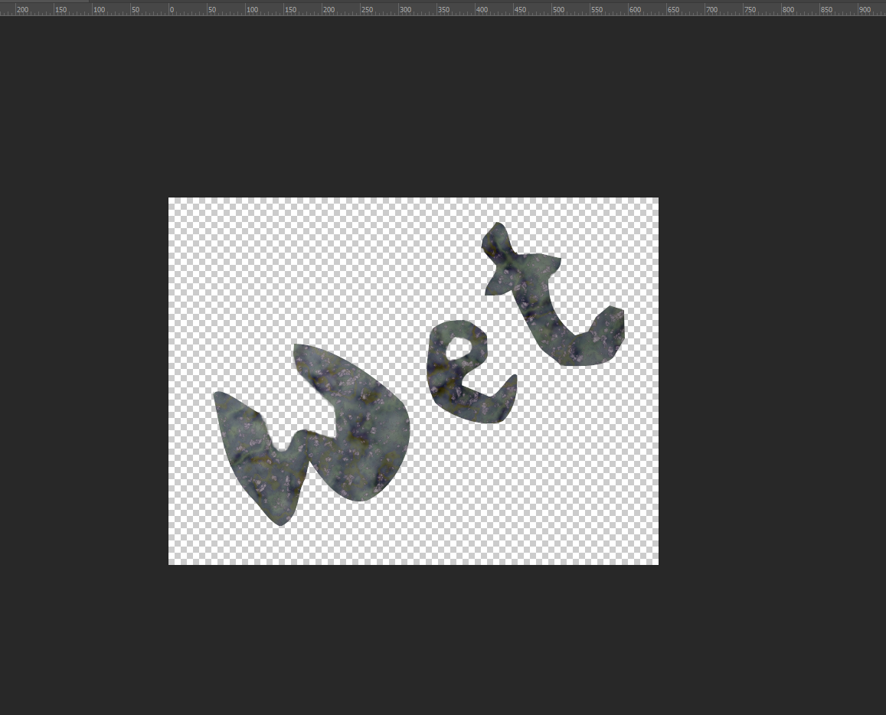
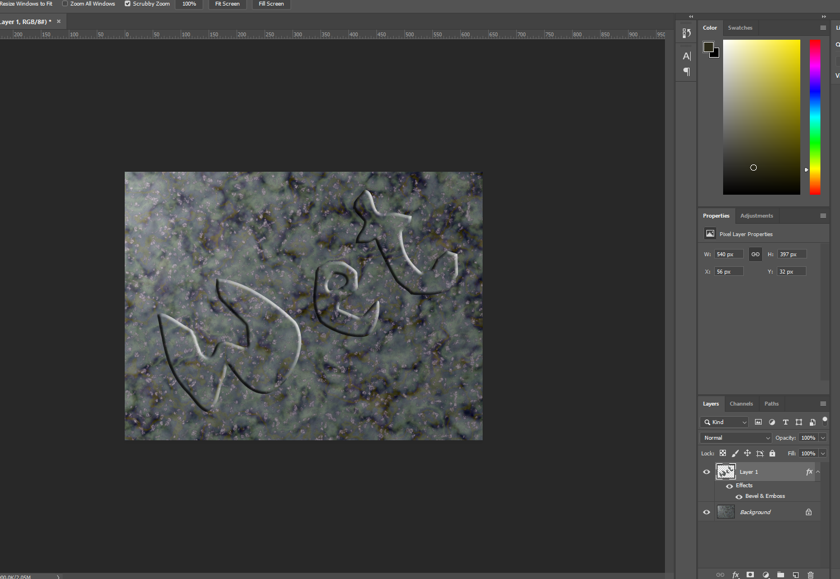
Step-1) Opened file STONE.TIF in Photoshop.
Step-2) Opened the Freeform Pen tool and create a new work path.
Step-3) Wrote Wet using pen tool.
Step-5) Converted the path to selection.
Step-6) Changed the Bevel & Emboss from Layer style.

